Slide 1

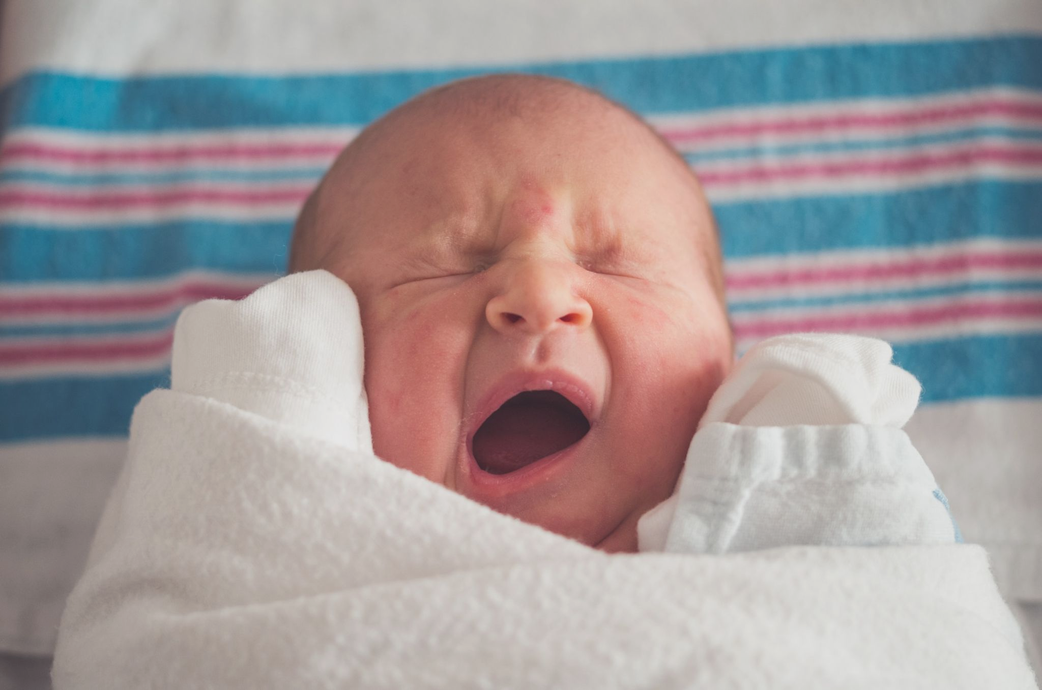
IOT PROJECT PRESENTATION
Aaditya Kumar(201010201), Apoorwa Gupta(201010212),
Shubham Raj Sahu (201010248) and Tavisha Thaware(201010255)

Slide 2

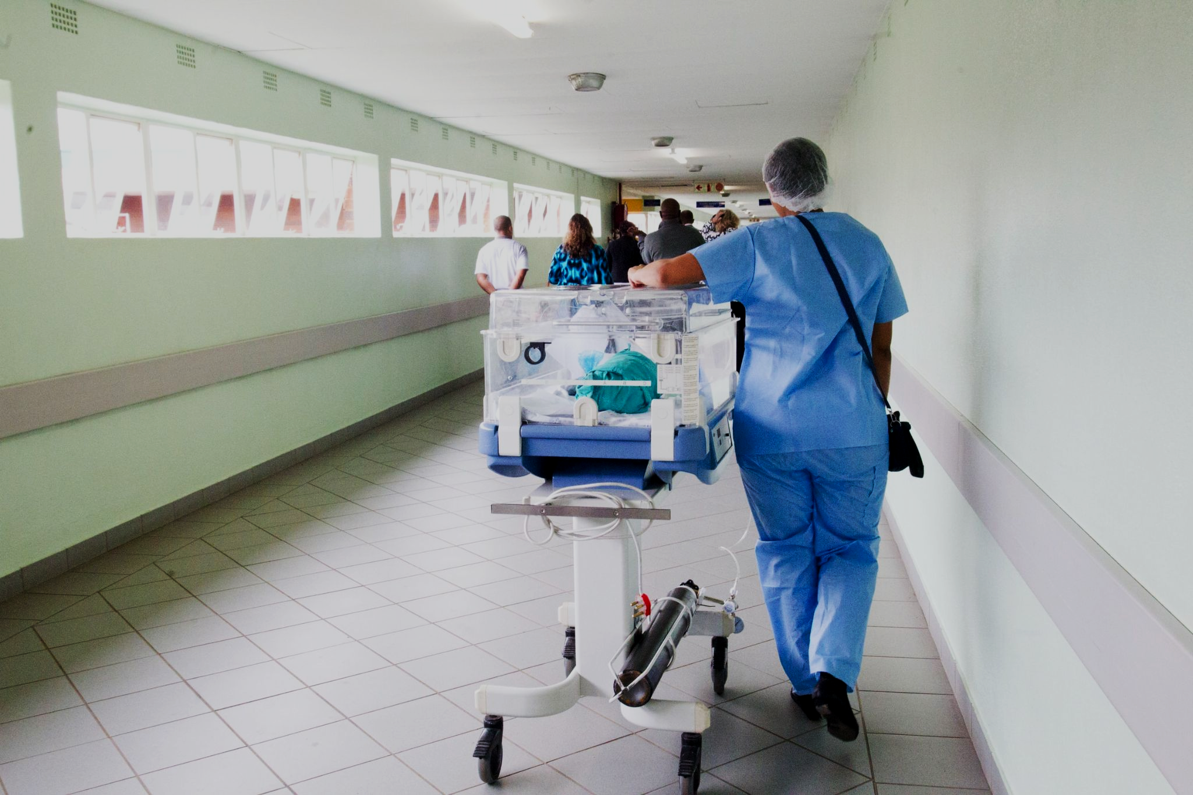
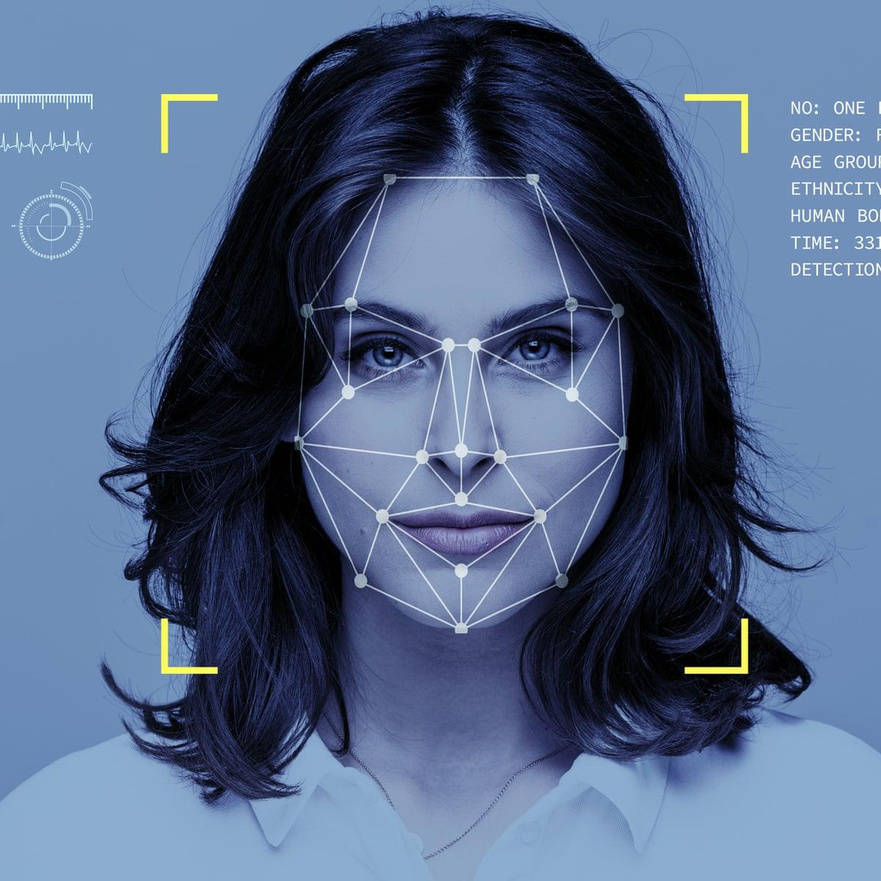
ABSTRACT
I N T R O D U C T I O N
An infant incubator is a device that consists of a hard box-like shell that allows an infant to be kept in a controlled environment for medical treatment.Temperature, relative humidity, and oxygen concentration are all maintained at a constant level in a neonatal incubator.
Incubators are used in conjunction with other equipment and methods to provide the greatest possible environment and continuous monitoring for babies who require special assistance.
Notes:
We develop an application of mask detection using a camera that functions as photo and video input and connected to Rpi to process data and display it to the LCD. If a person wear mask they will be in safe zone it display as green rectangle-box with safe alert whereas if person doesnt wear mask then it will be shown in red rectangle-box and with the message of Alert as well.

Slide 3
ABSTRACT
O B J E C T I V E S
Accumulating Real Time Data,Sensing multiple health parameters of the baby continuously, Incorporating the LED system for easy assessment of the situation and raid alert in case
of emergency.
2. Collecting and Storing the sensed data - It can help in better assessment and analysis of baby’s health. Cloud data storage and excel sheet for assessment for future references for doctors, web server for display of instantaneous data, and pushover app for alert notifications.
3. Providing this data to the parents of the baby - Efficient visual display of thingspeak data is easily accessible by the parents providing real time data about their baby. and enables them to keep track of their baby’s health conditions.
Notes:
We develop an application of mask detection using a camera that functions as photo and video input and connected to Rpi to process data and display it to the LCD. If a person wear mask they will be in safe zone it display as green rectangle-box with safe alert whereas if person doesnt wear mask then it will be shown in red rectangle-box and with the message of Alert as well.

Slide 4
ABSTRACT
C O M P O N E N T S U S E D
S N O . | NAME
 | ESP8266 -01 Development Board
2. | Arduino Uno
3. | LM35 Temperature sensor
4. | DHT11 Digital Humidity and Temperature Sensor
5. | MAX30100 I2C Pulse Oximeter Sensor
6. | LEDs
Notes:
We develop an application of mask detection using a camera that functions as photo and video input and connected to Rpi to process data and display it to the LCD. If a person wear mask they will be in safe zone it display as green rectangle-box with safe alert whereas if person doesnt wear mask then it will be shown in red rectangle-box and with the message of Alert as well.

Slide 5
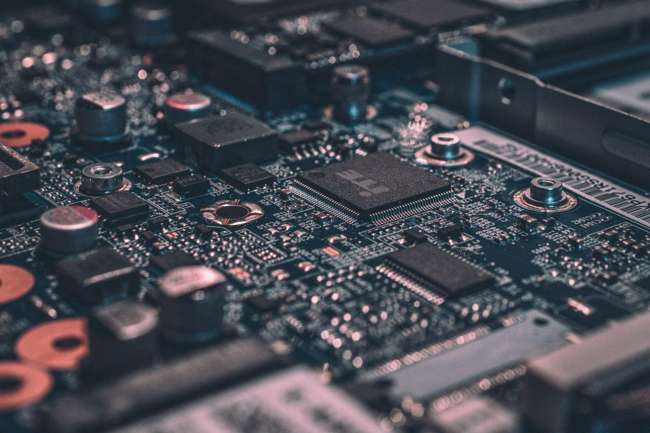
W O R K I N G
The three sensors, LM35 senses body temperature, MAX30100 senses pulse rate and oxygen saturation level, DHT11 senses humidity and ambient temperature, sense the respective data and this data is then collected at the micro-controller, Arduino UNO.
The microcontroller then sends instructions to the led to glow according to the range of the data sensed.
All this data is displayed in GUI Interface which is created when we run the python code, also the python code sends the data to thingspeak for storage.
The GUI Interface has an email button which sends a full day report to the doctor in csv format or an excel sheet format.
The report includes all the parameter with the date and time sensed.
The python code also allows us to send a notification to the baby’s parent through an app named Pushover.

Slide 6
W O R K I N G
This prototype has two cases - one for a premature baby and one for a mature baby.
Working of these cases is as follows -
Case 1 - For a Premature baby -
Glowing of an orange LED continuously indicates the presence of a premature baby in the incubator.
Condition 1 : Green Light Zero - Risk Condition parameters are within safe threshold
Condition 2 : Red Severe Risk - Need immediate attention For a premature baby any significant change from normal health conditions can be fatal, therefore we have removed the intermediate level of alert and added only a second emergency level
The threshold for this is narrower than Mature Baby ( if the heart bpm is greater than 150 or less than 80, or if the humidity is greater than 90%, or if the SpO2 level is less than 90, or if the ambient temp is greater than 38 degree celsius, , or if the body temperature is greater than 38 or less than 35 degree C)

Slide 7
W O R K I N G
Case 2 - For a Mature baby -
Condition 1 : Green Light Zero Risk - Condition parameters are within safe threshold
Condition 2 : Blue Intermediate Risk -If the body temp is lesser than 35 C or greater than 38 C
Condition 3 : Red Severe Risk - Need immediate attention if the heart bpm is greater than 150 or less than 80, or if the humidity is greater than 90%, or if the SpO2 level is less than 90, or if the ambient temp is greater than 38, or if the body temperature is greater than 38 or less than 35

Slide 8

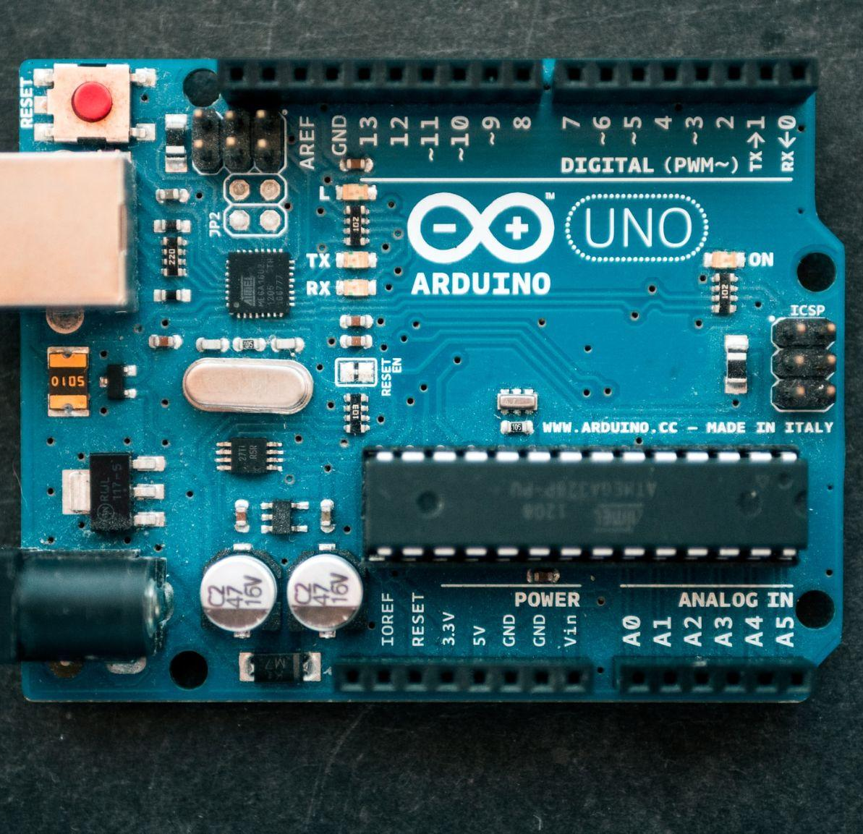
N O V E L T Y
1. Adding additional sensors amounting to 5 parameters tested and Integration of more than 2 sensors, of kinds - digital and analog .
2. Adding python based GUI web server for real time data values
3. The web server consists of an ‘email’ button which sends the whole record of the baby’s health parameters in an excel sheet as an email attachment to the doctor.
4. The LED system, which is one of a kind as compared to the previous implementations of the smart incubator

Slide 9
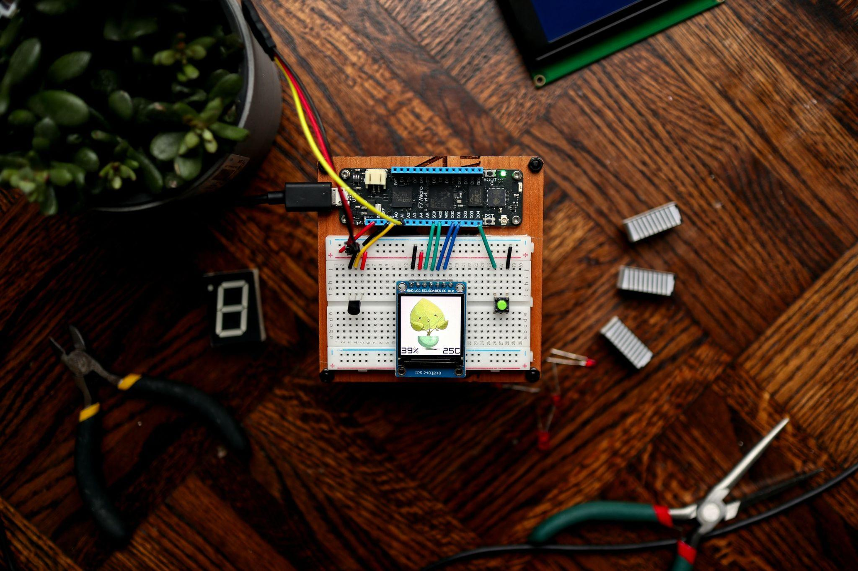
C O N C L U S I O N
By monitoring vital signs and intervening early, infant and newborn mortality can be reduced significantly. For a sick baby who has to be focused on treatment and requires a lot of attention to detect any symptoms or signs of infant ailments, real-time care is critical.
The system keeps track of the infant's heart rate as well as the temperature and humidity of the environment. Temperature monitoring is carried out to ensure that the neonate's surroundings are appropriate.
The system combines numerous functions into a single device, analyses data from sensors, and interacts with the device according to circumstances specified by conventional clinical research.
Notes:
We can not picture our everyday lives without electricity, as it has become a need for everybody, without which day-to-day life duties and activities come to a halt.

Slide 10
C O N C L U S I O N
The system is also simple to use. It can also aid parents, especially those in rural areas, by reducing their number of visits to the hospital and stress by being timely updated with their child's health progress.
Notes:
We can not picture our everyday lives without electricity, as it has become a need for everybody, without which day-to-day life duties and activities come to a halt.

Slide 11

V I D E O
Notes:
We can not picture our everyday lives without electricity, as it has become a need for everybody, without which day-to-day life duties and activities come to a halt.

Slide 12
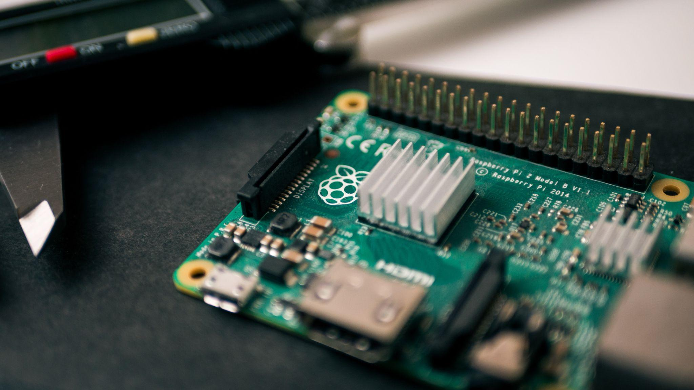
R E F E R E N C E S
1. M. Koli, P. Ladge, B. Prasad, R. Boria and N. J. Balur, "Intelligent Baby Incubator," 2018 Second International Conference on Electronics, Communication and Aerospace Technology (ICECA), 2018, pp. 1036-1042, doi: 10.1109/ICECA.2018.8474763.
2. https://github.com/kishorens77/Patient-Health-Monitoring-System
3. Nayana P N, Umme Hani R, Latha M, Ameena Khan, Bindu Reddy L, 2020, Design of a Portable Real-Time Health Monitoring Model using IOT and Thing Speak, INTERNATIONAL JOURNAL OF ENGINEERING RESEARCH & TECHNOLOGY (IJERT) IETE – 2020 (Volume 8 – Issue 11)
4. B. Ashish, "Temperature monitored IoT based smart incubator," 2017 International Conference on I-SMAC (IoT in Social, Mobile, Analytics and Cloud) (I-SMAC), 2017, pp. 497-501, doi: 10.1109/I-SMAC.2017.8058400.
Notes:
We can not picture our everyday lives without electricity, as it has become a need for everybody, without which day-to-day life duties and activities come to a halt.

Slide 13
T H A N K Y O U

